Slide 1
CS-474 Computer Vision
Lecture 2
Dr. Shahid Ismail

Slide 2
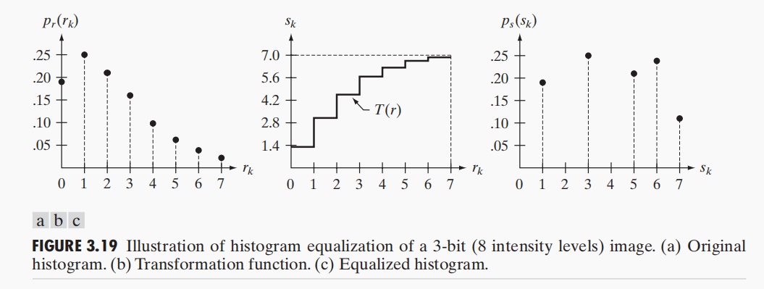

Slide 3
